Slide 1
OpenCV disparity results using stereo images and a disparity filter & Exploring close object images and their corresponding performance

Slide 2
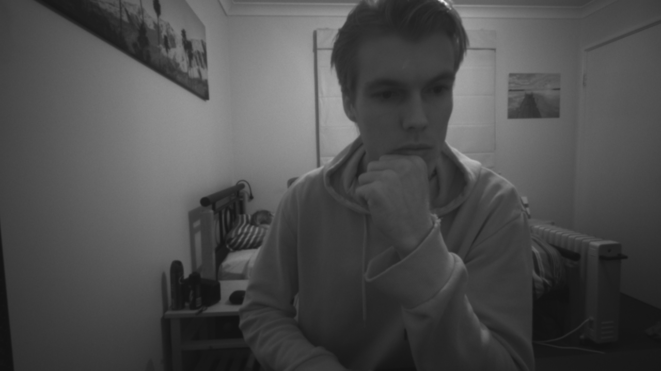

Slide 3
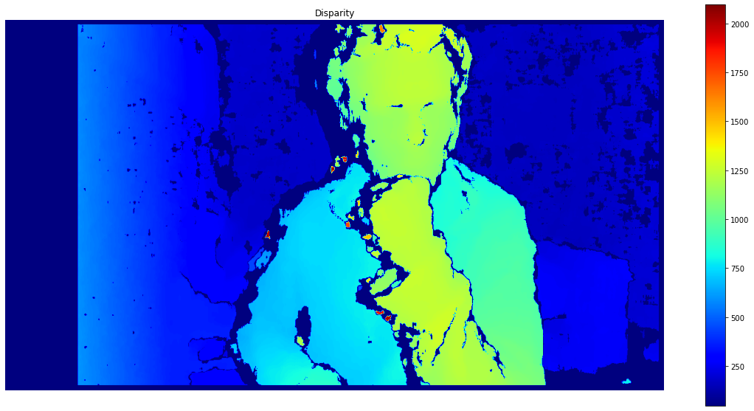

Slide 4
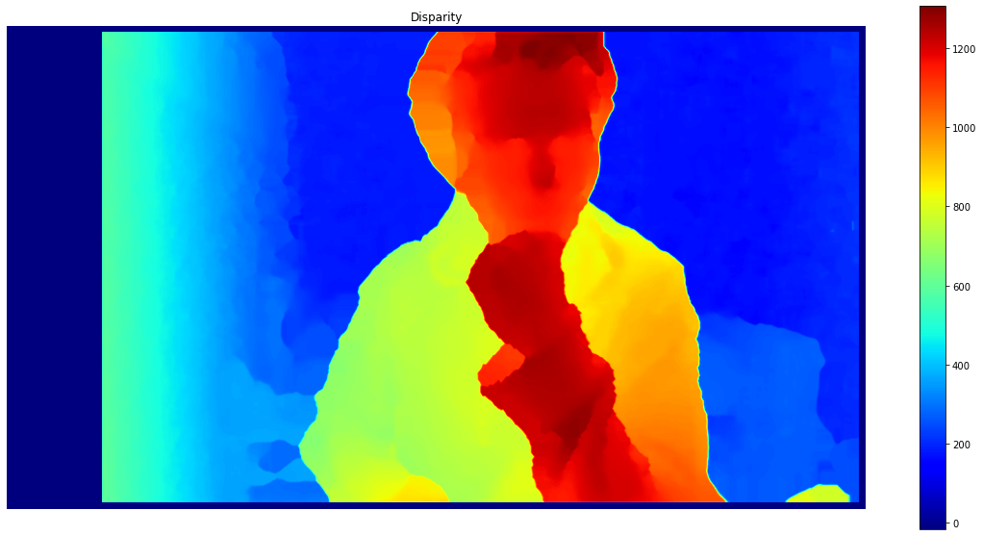

Slide 5
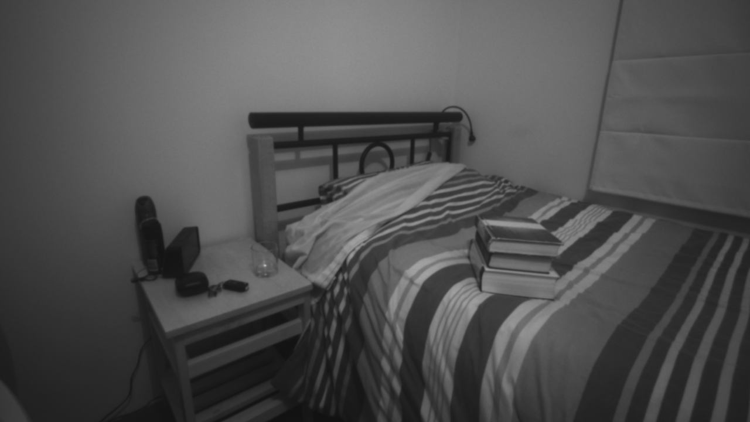

Slide 6
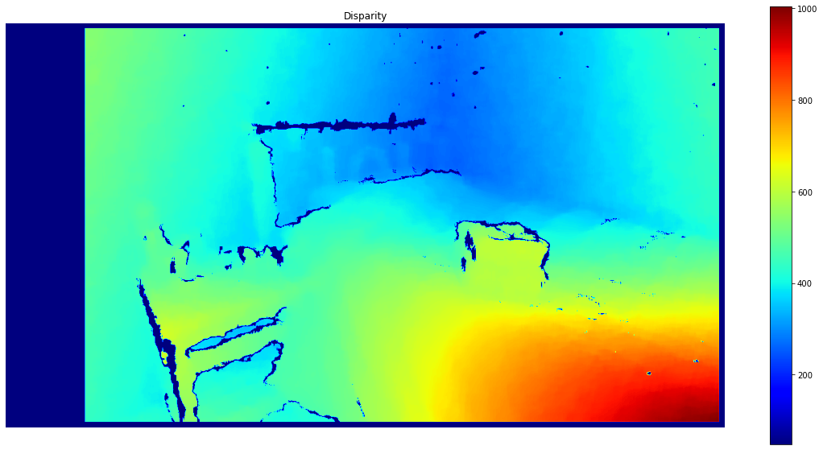

Slide 7
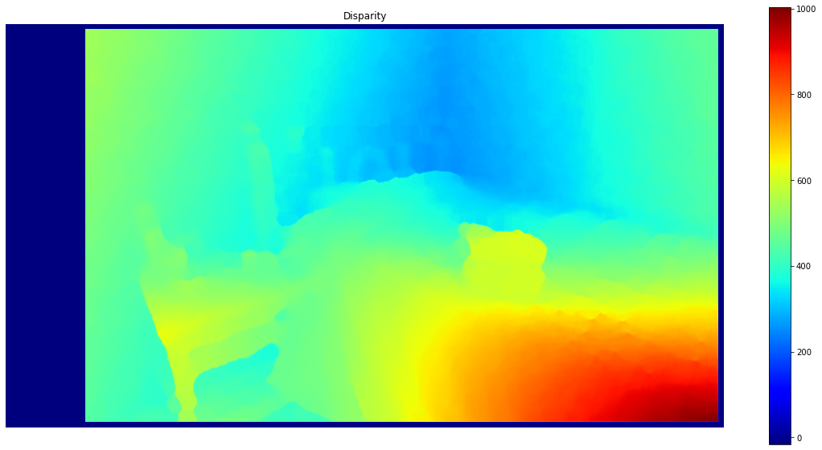

Slide 8
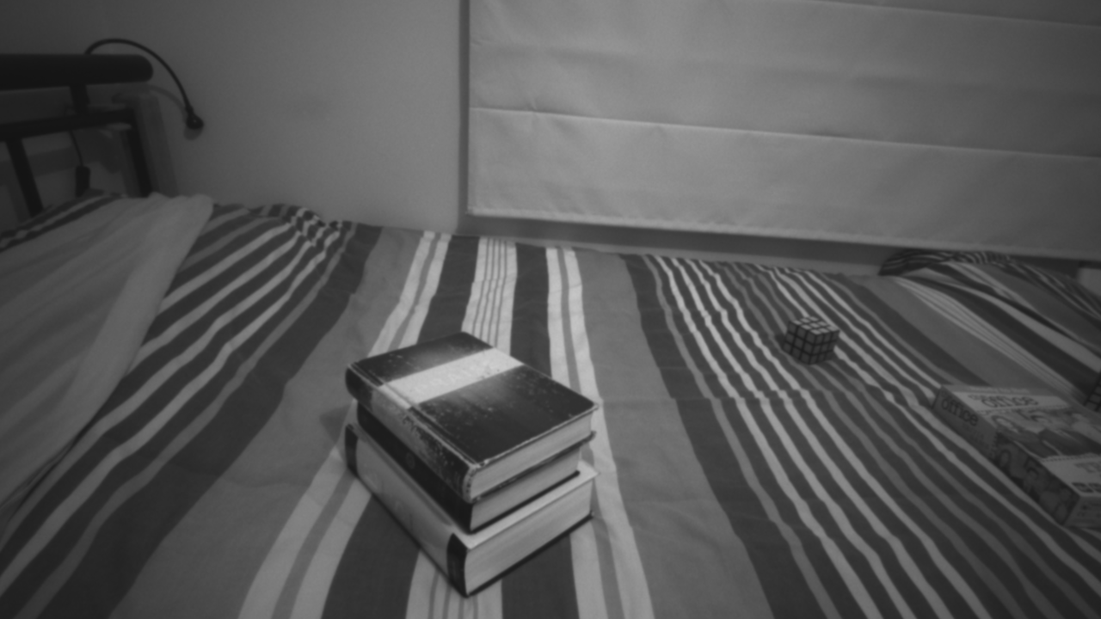

Slide 9
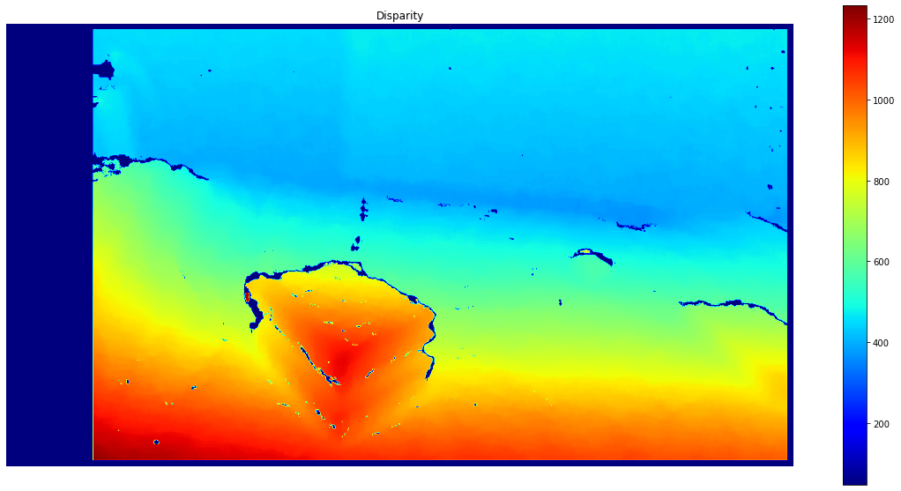

Slide 10
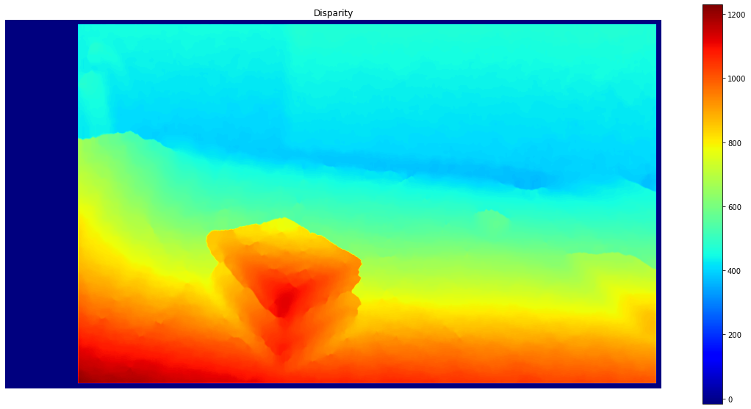

Slide 11
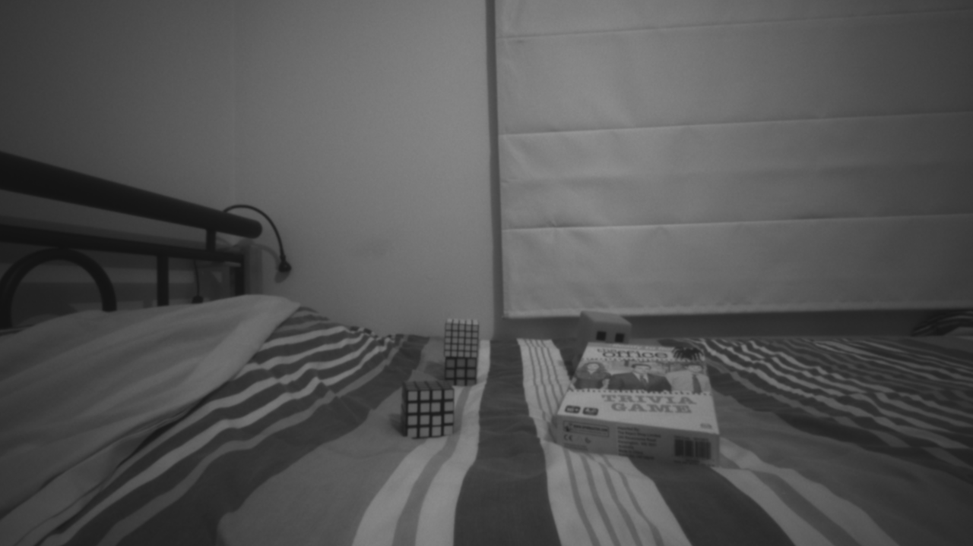

Slide 12
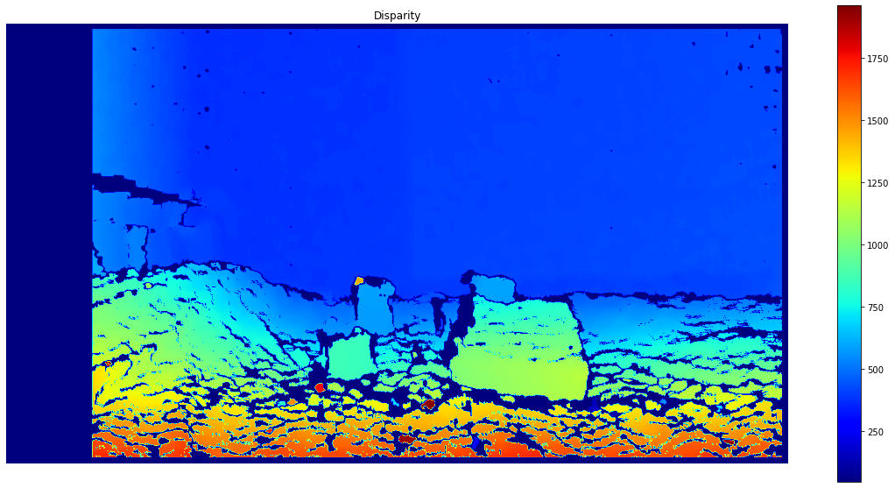

Slide 13
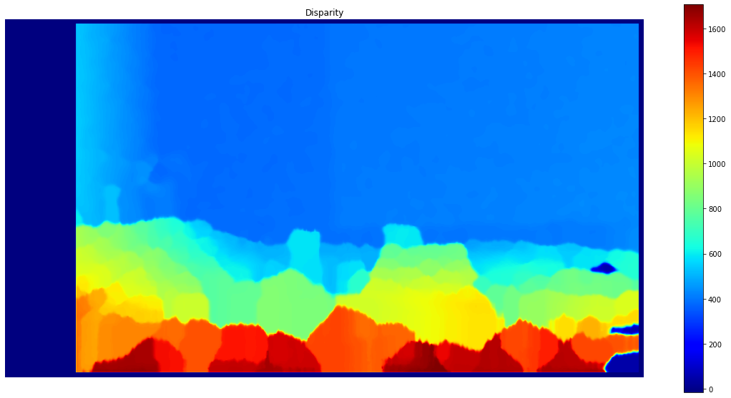

Slide 14
Notes:
Filter doesn’t seem to be able to nicely filter not great disparity surfaces as was the last example
Filter also fills in the blank spaces created from depth movement, making the depth object larger in the smoothed output
Still has the blocks in the disparity with correct depth just not a smooth output
With close images (within 0.2 from the camera) we cannot calculate disparity and therefore the smoothness is not great at all
The last example below, is very cool, calculating depth and smoothing nicely just not in the region of my hand passing the camera showing exactly where the depth starts to fail

Slide 15
Closer picture examples

Slide 16
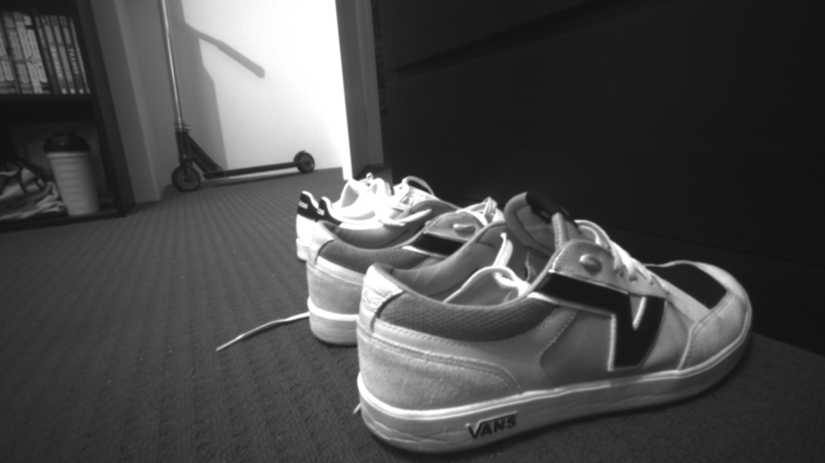

Slide 17
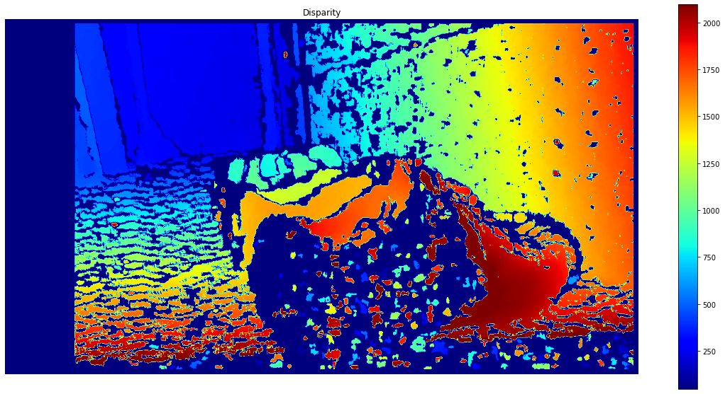

Slide 18
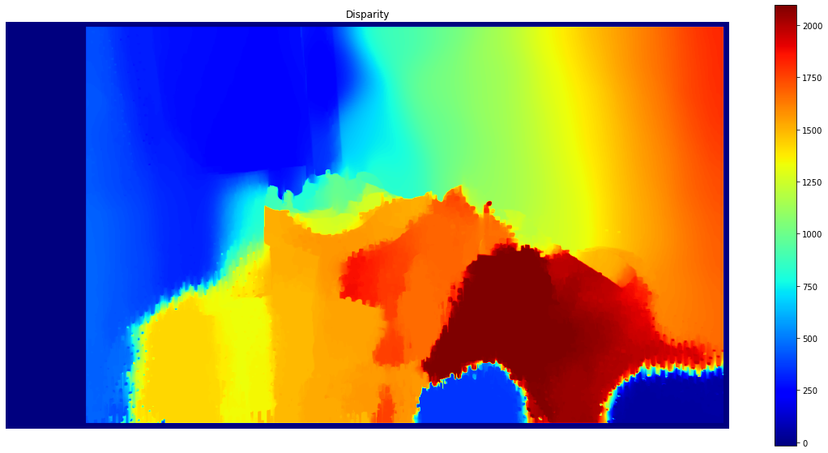

Slide 19
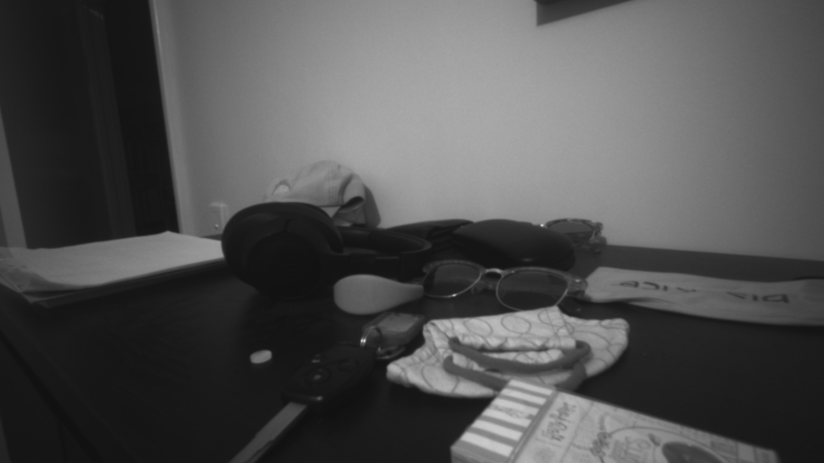

Slide 20
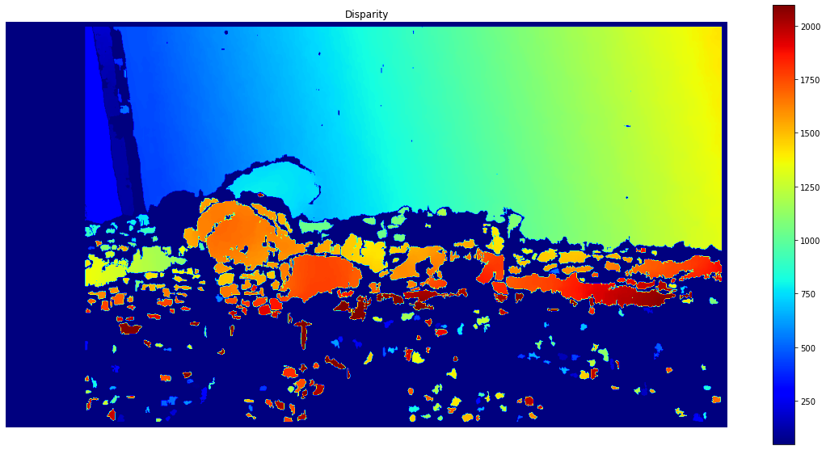

Slide 21
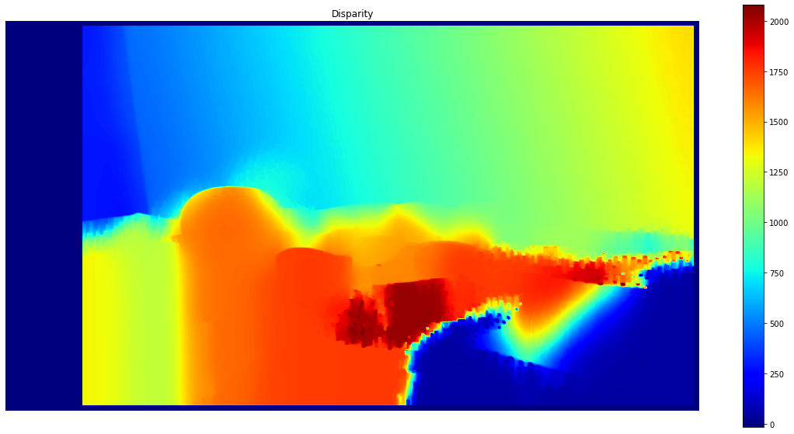

Slide 22
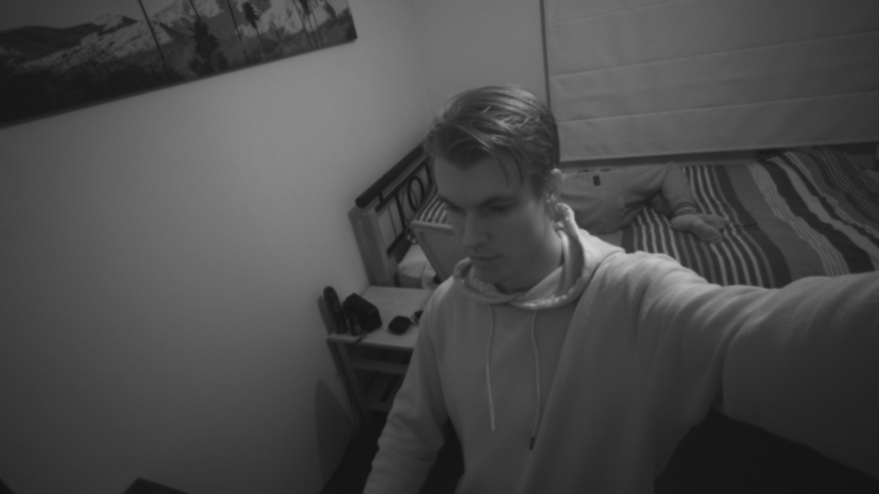

Slide 23
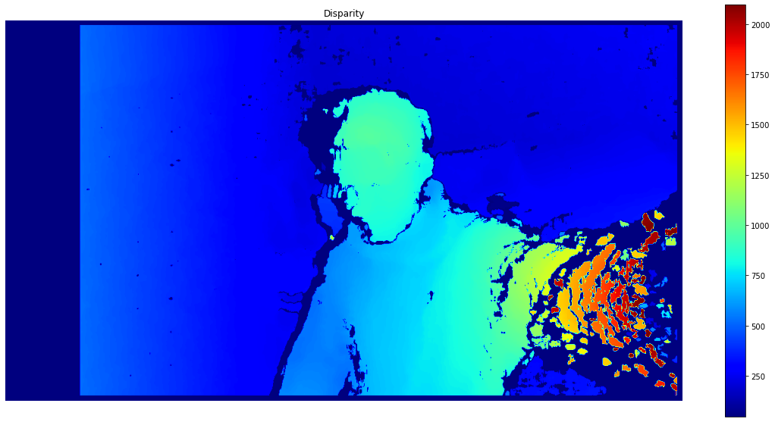

Slide 24
